Slide 1
Digital Portfolio
STUDENT NAME : Ajay A
REGISTER NO AND NMID : 222402511/asnum161222402511
DEPARTMENT : BSc.Computer science
COLLEGE: COLLEGE/ UNIVERSITY : Prince Shri Venkateswara Arts
And Science College/Madras University

Slide 2
PROJECT TITLE :
Digital Portfolio

Slide 3


AGENDA
Problem Statement
Project Overview
End Users
Tools and Technologies
Portfolio design and Layout
Features and Functionality
Results and Screenshots
Conclusion
Github Link
3/21/2024 Annual Review

Slide 4

PROBLEM STATEMENT
Resumes and profiles often feel static and fail to show creativity or real skills. A digital portfolio provides an engaging way to present projects, talents, and achievements more effectively..

Slide 5

PROJECT OVERVIEW
This digital portfolio is designed to showcase my skills, projects, and achievements in a modern and interactive way. It contains containers for my skills,about me and contact information. The goal is to create a single platform where employers, clients, and collaborators can easily explore my work and understand my capabilities.

Slide 6

WHO ARE THE END USERS?
Potential Employers/Recruiters – to evaluate skills, projects, and experience.
Clients/Collaborators – to explore work samples before partnerships.
Peers/Community – for networking, learning, and inspiration.

Slide 7

TOOLS AND TECHNIQUES
Vs code - Code Editor
HTML – Structure purpose
CSS – Styling purpose
Javascript – Interactive purpose
Github – Hosting Platform

Slide 8
POTFOLIO DESIGN AND LAYOUT
Layouts Included:
Home
About Me
Projects
Skiils
Contact info
Contact Me Form
8

Slide 9
FEATURES AND FUNCTIONALITY
Contains Navigation Bar
Has Smooth Scrolling feature
Pop up animations for containers and buttons
Glowing effect for conatiners and button
Has a Form validation

Slide 10
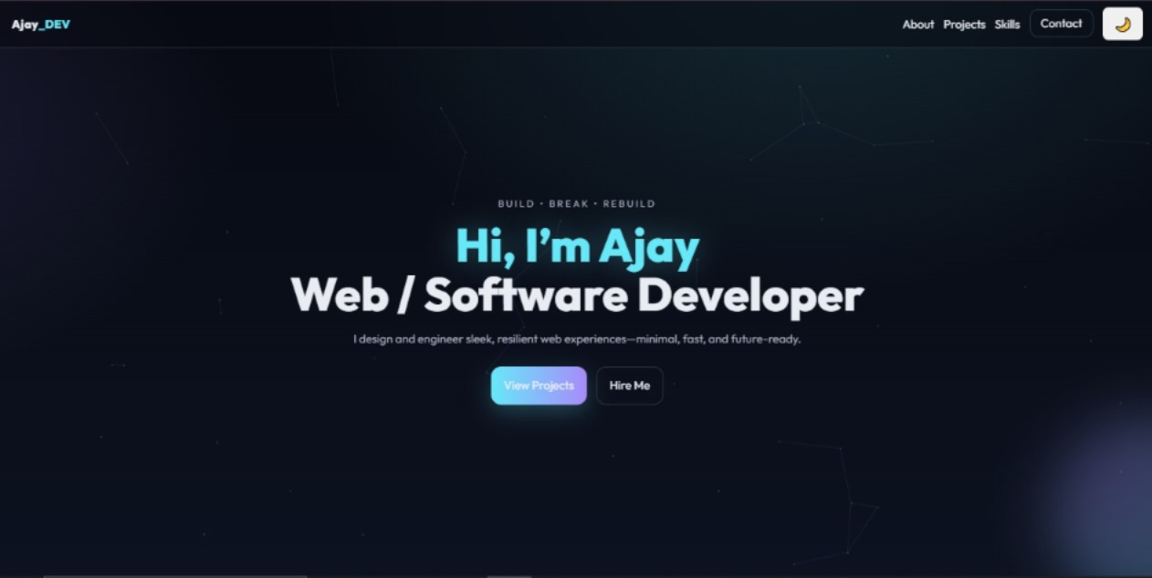

RESULTS AND SCREENSHOTS
3/21/2024 Annual Review
10

Slide 11
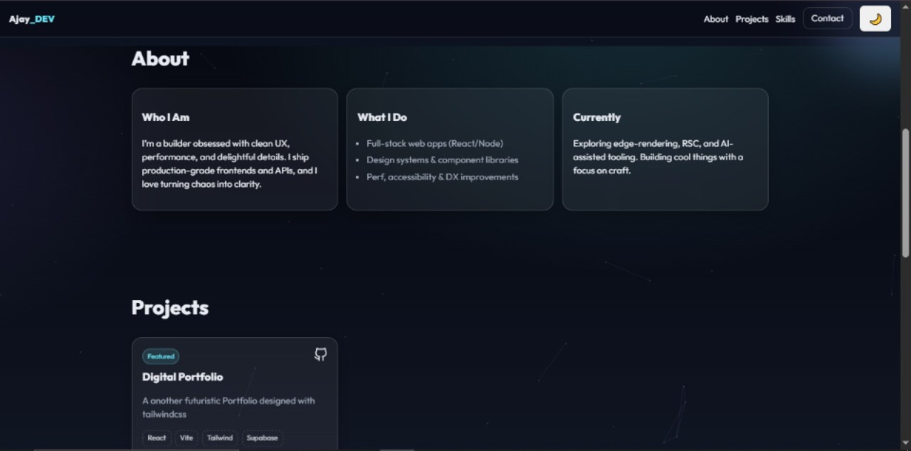

Slide 12
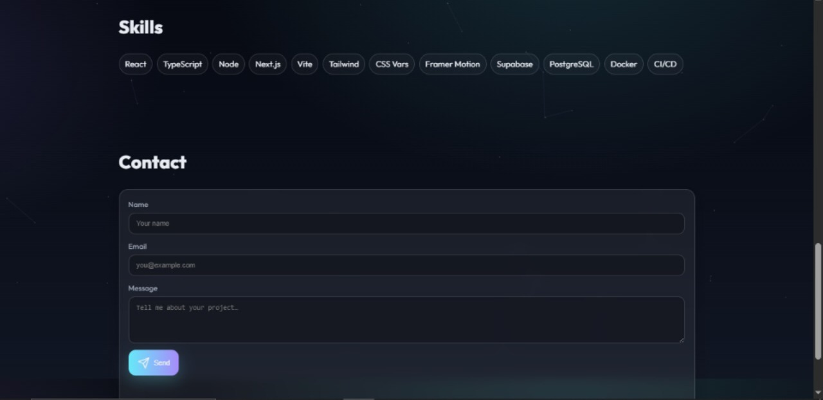

Slide 13
CONCLUSION
A digital portfolio is more than just a resume — it’s a creative way to showcase who I am, what I can do, and the work I’m proud of. It helps me stand out, connect with opportunities, and grow in today’s digital world.
13

Slide 14
𝙶𝚒𝚝𝚑𝚞𝚋 𝙻𝚒𝚗𝚔:
https://ajay-a-74.github.io/TNSDC-FWD-DP/#projects

